Slide 1
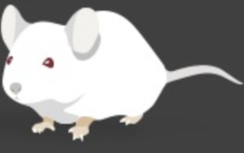
RaMP Student Researcher Experience in the Cornwall Laboratory
Annie Emmert
Mentor: Dr. Qing Goh

Slide 2
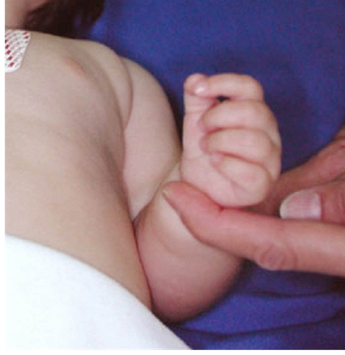
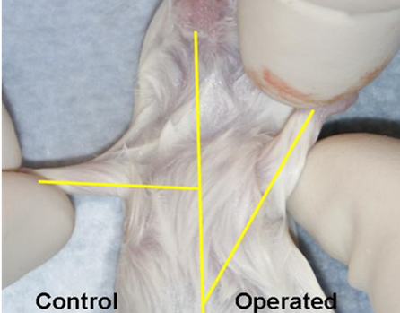
The Cornwall Laboratory
Division of Orthopaedics at Cincinnati Children’s Hospital Medical Center
Cerebral palsy and neonatal brachial plexus injury
Most common causes of paralysis in children
Induces muscle contractures
Muscle contractures
Physically debilitating
Severely impair function and mobility in affected limbs
Currently incurable
Current project: Determine the efficacy of bortezomib in preventing contractures in a mouse model of neonatal brachial plexus injury

Slide 3
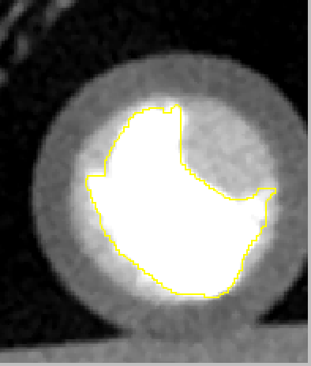
My Research
Measure and record weights of mice
Prepare drugs and assist with drug injections
Observe the surgeries that induce contractures in mice
Investigate the size of skeletal muscles in mice

Slide 4
So What?
Professional Growth
First experience working in a biomedical research laboratory
Working alongside medical professionals
Observing surgeries from an internationally-renowned pediatric hand surgeon
Opportunities to contribute to a scientific manuscript and to present my research
Personal Growth
Collaborative work environment
Learning to ask questions when necessary
Making a direct impact on another person’s life

Slide 5
Now What?
Summer plans
Continue research for the Cornwall Laboratory
Long-term goal of becoming a physician
Biomedical research and scientific advances at the forefront of medicine
Thank you to the Cornwall Lab and to the University Honors Program for granting me this invaluable opportunity!
Photo by Cincinnati Children’s Hospital website
Photo by University Honors Program website

